Slide 1

KPMG Virtual Internship
Data Analytics Approach using python
Nikhil Gupta

Slide 2
Agenda
Introduction
Data Exploration
Model Development
Interpretation

Slide 3
Introduction
Identify and Recommend Top 1000 Customer to target from dataset.
Outline Problem
Sprocket Central is a company that specializes in high quality bikes and cycling accessories.
They are looking to boost business sales by analyzing provided datasets.
Using the 3 datasets provided the aim is to analyze and recommend 1000 customers that the company should target to drive higher value for the company.
Contents of Data Analysis
Comparing the customer age distributions.
Comparing the bike related purchases on the basis of gender.
Comparing job industry distributions.
Comparing wealth segment by age.
Number of cars owned by state category.
RFM analysis and customer classifications.
This can be done with three steps:-Data Exploration, Model Development, Interpretation

Slide 4
Data Exploration
Data Quality Assessment and Clean Up
Summary Table
Key Issues for Data Quality Assessment
Accuracy: Correct Values
Completeness: Data Fields with Values
Consistency: Values Free from Contradictions
Relevancy: Data Items with Value Meta-Data
Validity: Data Containing Allowable Values
Uniqueness: Duplicated Values
 | Accuracy | Completeness | Consistency | Relevancy | Validity
Customer Demographic | DOB: inaccurate, Age: missing | Job Title: blank, Customer Id: Incomplete | Gender: inconsistency | Default column delete
Customer Address |  | Customer Id: Incomplete | States: inconsistency
Transactions | Profit: missing | Customer Id: Incomplete, Online order: blanks, brand: blanks |  | Cancelled Status order filter out | List Price : format

Slide 5
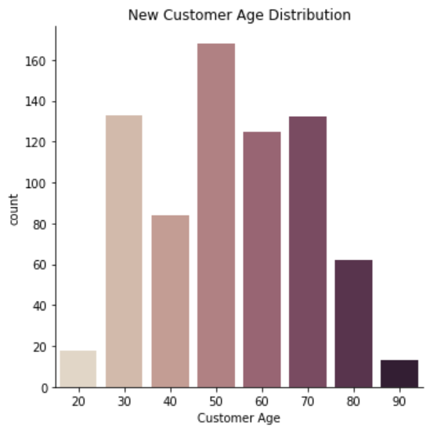
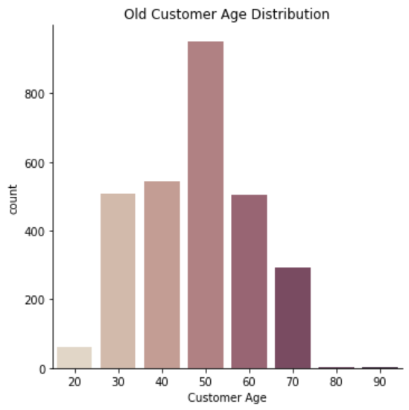
Data Exploration
‘New’ & ‘Old’ Customer Age Distribution
Most of the customers are in 40-49 (50) in both ‘New’ and ‘Old’ category.
The lowest age groups are 20 and 80+ for both the categories
There is a sudden drop in 30-39 (40) in ‘New’ category.

Slide 6
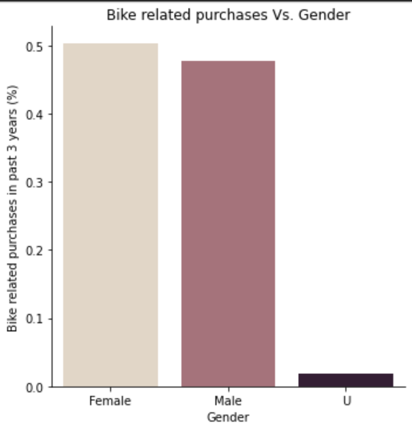
Data Exploration
Bike related purchases over last 3 years by gender (%)
Over the last three years, 50% of the purchases were bought my females and 47% by males. 3% were made by unknown gender.
Females purchase more bike related accessories in general.

Slide 7
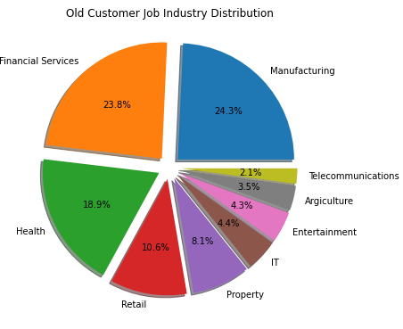
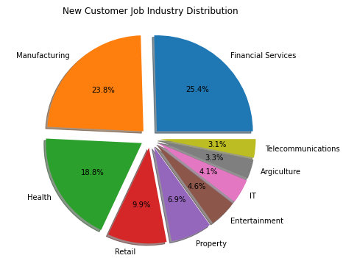
Data Exploration
Job Industry Distribution
Maximum number of customers are in Financial & Manufacturing sectors. They together constitute around 50%.
Minimum number of customers are in Telecommunications and Agriculture sectors.

Slide 8
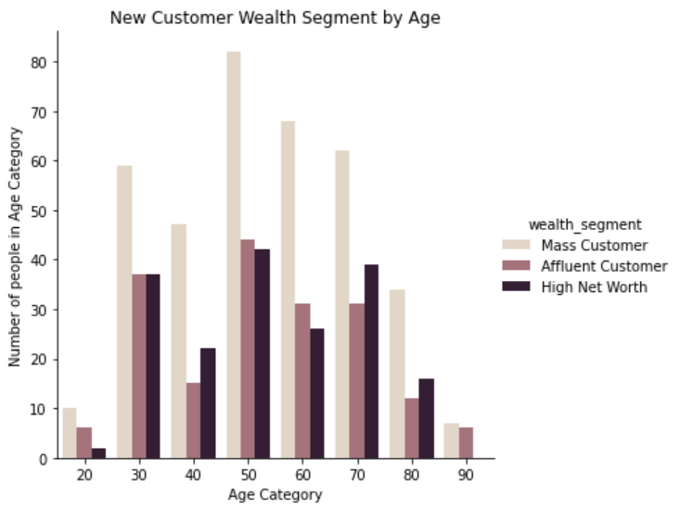
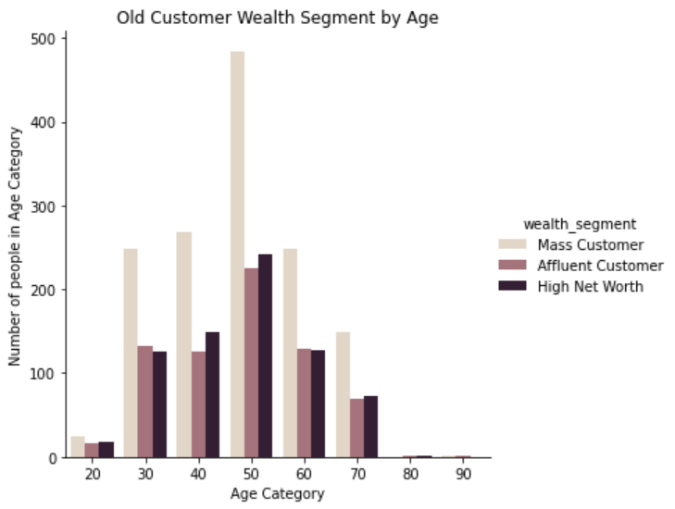
Data Exploration
Wealth Segment by Age Category
The largest number of customers are classified as ‘Mass Customers’. And are present in 40-49 (50) category.

Slide 9
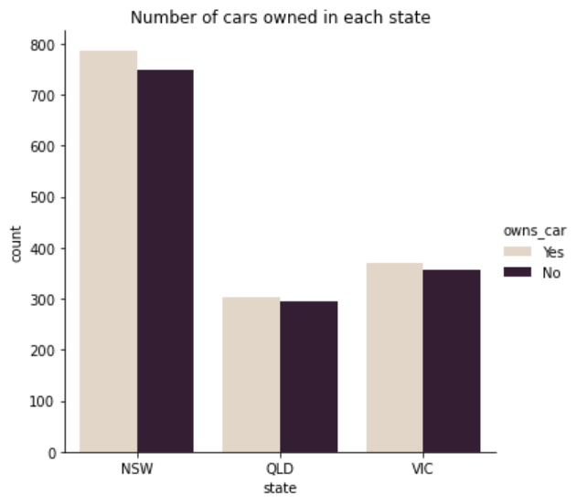
Data Exploration
Number of cars owned and not owned in each state
Maximum number of people who own and not own cars are present in NSW state.
Least number of people who own and not own cars are present in QLD state.

Slide 10
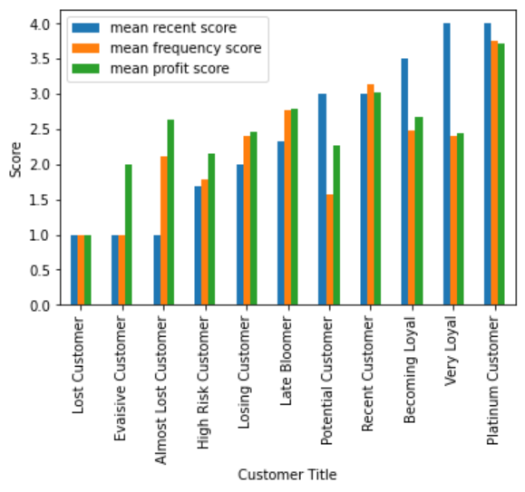
Model Development
RFM Analysis & Customer Classification
RFM analysis is used to determine which customers a business should target to increase its revenue.
Some of the top customers are present in ‘Platinum’ , ‘Very Loyal’ and ‘Becoming Loyal’ range.

Slide 11
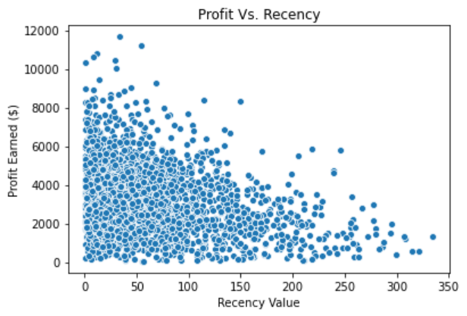
Model Development
Scatter Plot based off RFM analysis
The plot shows people who have purchased more recently have generated more revenue, than customers who visited a while ago.
Those who visited more than 200 days ago have generated very less revenue.

Slide 12
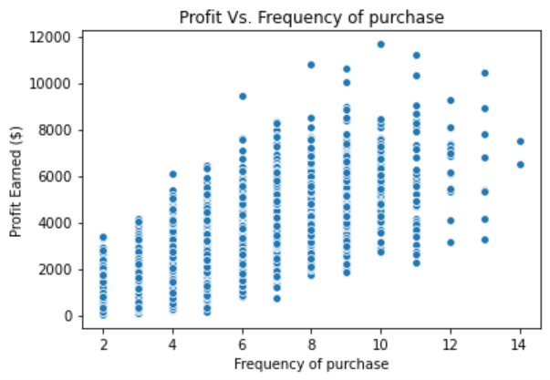
Model Development
Scatter Plot based off RFM analysis
Naturally, there is a positive correlation between profit earned and frequency of purchase.

Slide 13
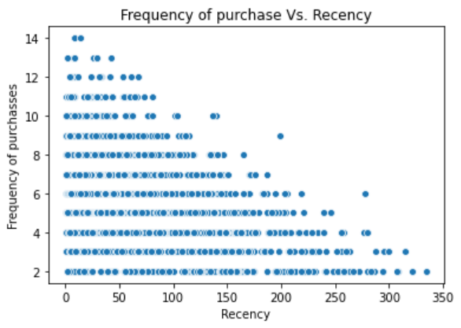
Model Development
Scatter Plot based off RFM analysis
The plot shows that very recent customers are also frequent buyers i.e. frequency of purchases has negative relationship with recency.
Customers who have visited more recently have a higher chance of visiting more frequently.

Slide 14
Model Development
Customer Title definition with assigned RFM values
Rank | Customer Tilte | Description | RFM Value
1 | Platinum Customer | Most recent buy, buys often, most spent | 111
2 | Very Loyal | Most recent buy, buys often | 112
3 | Becoming Loyal | Relatively recent buy, bought more than once, spends average amount of money | 133
4 | Recent Customer | Bought recently, average money spent | 212
5 | Potential Customer | Bought recently, not very often, spent average amount | 233
6 | Late Bloomer | No Purchases recently, above average RFM value | 311
7 | Losing Customer | Purchases was while ago, below average RFM value | 323
8 | High Risk Customer | No Purchases recently, frequency is less | 343
9 | Almost Lost Customer | Very low recency, low frquency but high money spent | 412
10 | Evaisive Customer | Very low recency, low frquency , below average money spent | 433
11 | Lost Customer | Very low recency, low frequency and less money spent | 444

Slide 15
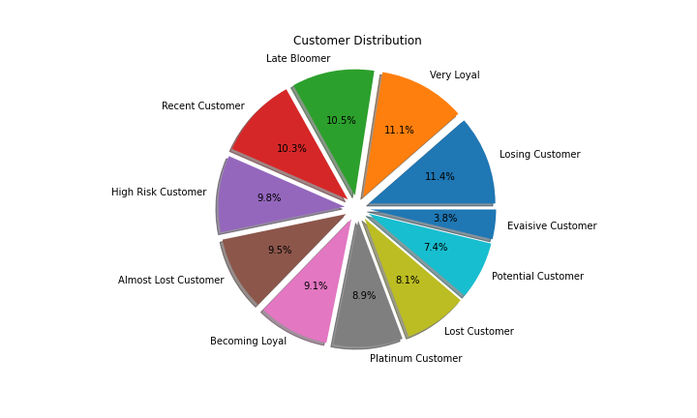
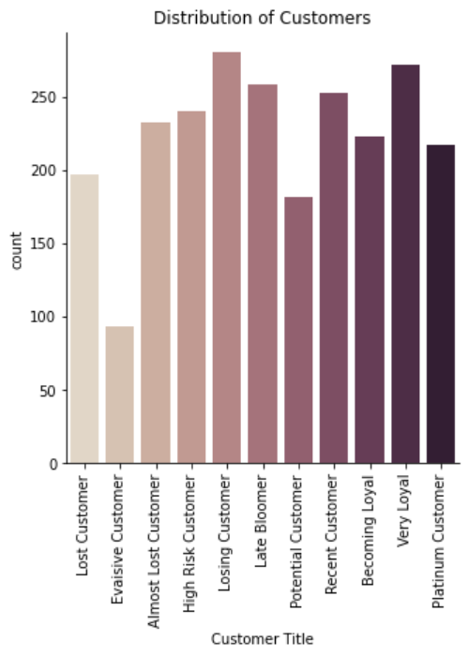
Model Development
Additional Graphs

Slide 16
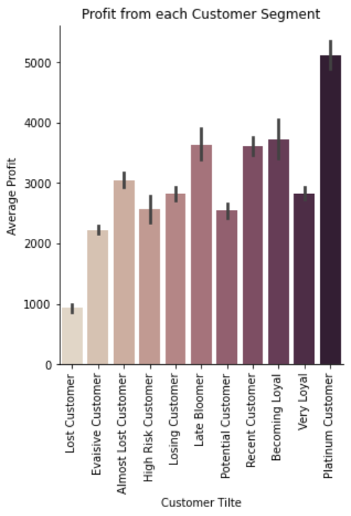
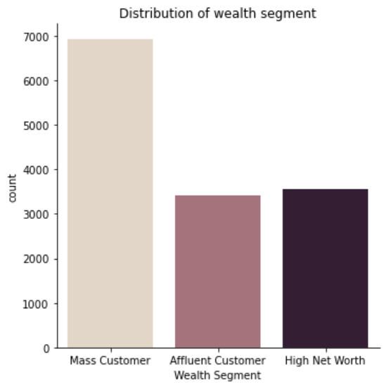
Additional Graphs

Slide 17
Interpretation
Summary table of the top 1000 Customers to target
Rank | Customer Tilte | Description | No. of customers | Cumulative | Customer Selection
1 | Platinum Customer | Most recent buy, buys often, most spent | 217 | 217 | 217
2 | Very Loyal | Most recent buy, buys often, spends large amount of money | 272 | 489 | 272
3 | Becoming Loyal | Relatively recent buy, bought more than once, spends relatively less amount of money | 223 | 712 | 223
4 | Recent Customer | Bought recently, average money spent | 253 | 965 | 253
5 | Potential Customer | Bought recently, not very often, spent small amount | 182 | 1147 | 35
6 | Late Bloomer | No Purchases recently, above average RFM value | 258 | 1405 | 0
7 | Losing Customer | Purchases was while ago, below average RFM value | 280 | 1685 | 0
8 | High Risk Customer | No Purchases recently, frequency is less | 240 | 1925 | 0
9 | Almost Lost Customer | Very low recency, low frquency but high money spent | 232 | 2157 | 0
10 | Evaisive Customer | Very low recency, low frquency , below average money spent | 93 | 2250 | 0
11 | Lost Customer | Very low recency, low frequency and less money spent | 197 | 2447 | 0

Slide 18
Interpretation
Customer target and methodology
Rank | Customer Tilte | Description | No. of customers | Cumulative | Customer Selection
1 | Platinum Customer | Most recent buy, buys often, most spent | 217 | 217 | 217
2 | Very Loyal | Most recent buy, buys often, spends large amount of money | 272 | 489 | 272
3 | Becoming Loyal | Relatively recent buy, bought more than once, spends relatively less amount of money | 223 | 712 | 223
4 | Recent Customer | Bought recently, average money spent | 253 | 965 | 253
5 | Potential Customer | Bought recenetly, not very often, spent small amount | 182 | 1147 | 35
Filter through the top 1000 customers by assigning the conditions discussed in the table above.
The 1000 customers discovered would have bought recently, more frequently and tend to spend more than the average.

